Slide 1



Welcome to Our Game Web Application!

Slide 2

“Space Ball Shooter”

Slide 3


Technology Used
HTML
CSS
JAVA SCRIPT
JSON

Slide 4
“Code For the Project”

Slide 5
“Glimpse For the Project”

Slide 6
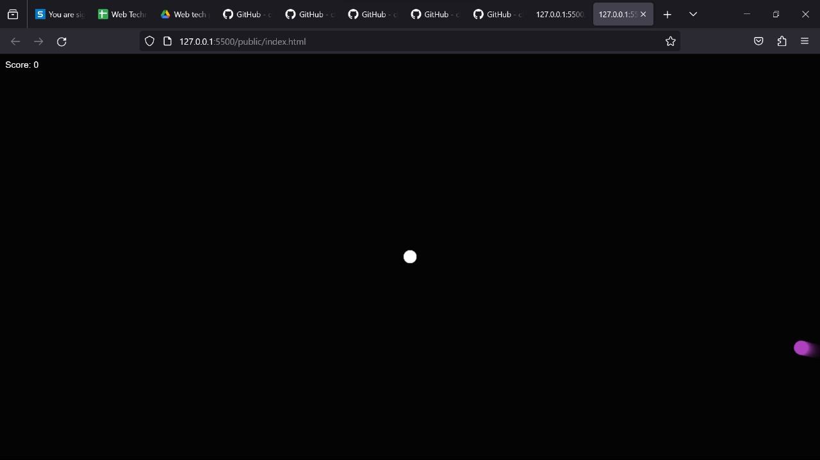


Slide 7
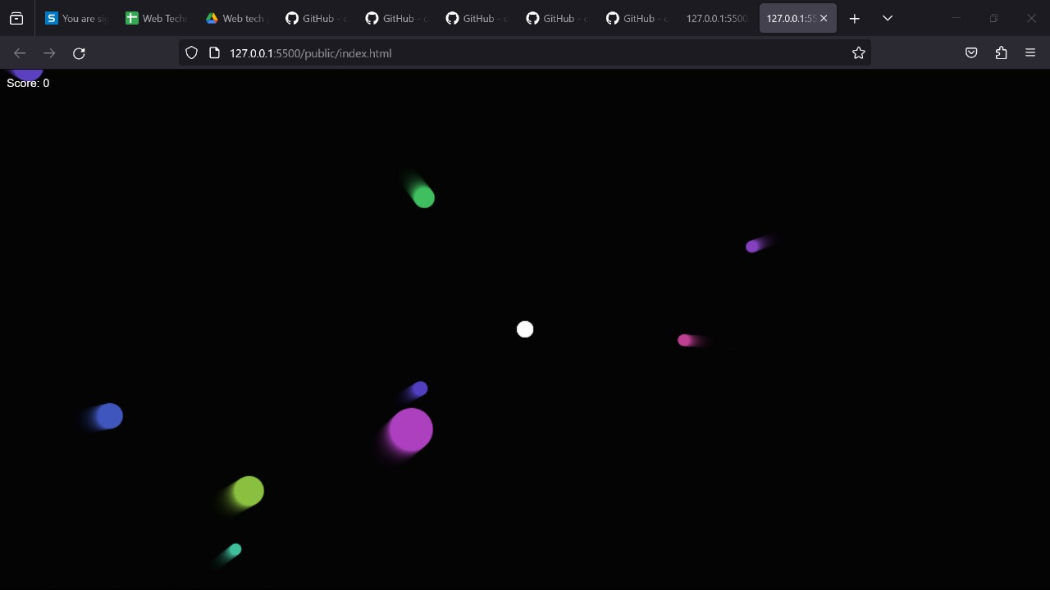

Slide 8
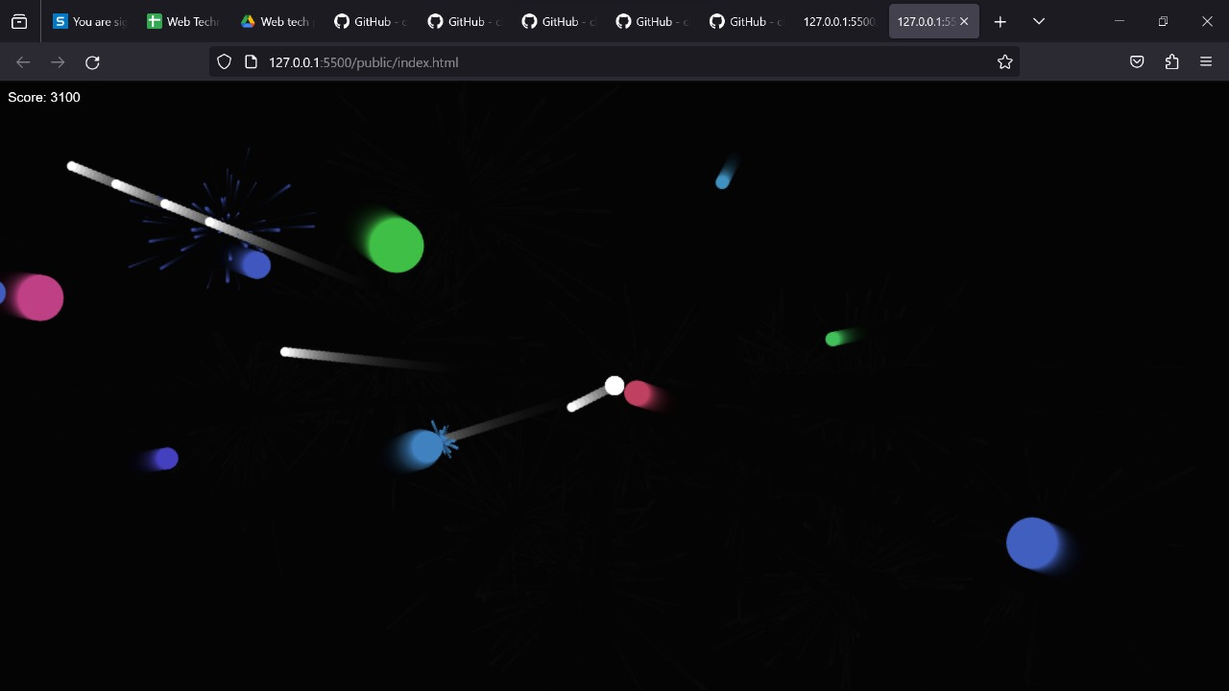

Slide 9


Game On
Here is a Demo !

Slide 10
Thank You

